Slide 1
Chinese Electronic Medical Records Extraction
Xu Dong
2015-05-20

Slide 2
Outline
Motivation
Approaches
Evaluation
Conclusion

Slide 3
Motivation
Electronic Medical Records (EMRs) are full of valuable information.
Discovery the effect of a certain drug.
Uncover unmet medical needs.
Propose a data-driven framework that takes unstructured free text narratives in Chinese electronic medical records (EMRs) as input and converts it into structured time-event-description triples.

Slide 4
患者7天前无明显诱因下开始出现咽痒、咳嗽、咯痰，咯痰色黄，质粘，无咽痛，无鼻塞流涕，无恶寒发热，6月19日到我院门诊就诊，虑为急性上呼吸道感染，予口服酮替芬、喉特灵、复方甲氧那明胶囊及中药汤剂治疗，经治疗后患者咽痒、咳嗽未见明显缓解。6月22日患者再次到我院，行肺功能示：FEV1/FVC小于70％。
Index Time Term Description
1 7天前 咽痒
2 7天前 咳嗽
3 7天前 咯痰
4 7天前 咯痰 色黄, 质粘
5 6月19日 酮替芬
6 6月19日 喉特灵
7 6月19日 复方甲氧那明 予口服
8 6月19日 咽痒 未见明显缓解
9 6月19日 咳嗽 未见明显缓解
10 6月22日 肺功能 FEV1/FVC 小于 70％

Slide 5
Workflow

Slide 6
Lexicon Enrichment
Core lexicon including Systematized Nomenclature of Medicine-Clinical Terms, Chinese Pharmacopoeia, Wangfang Med Online, Baidu Baike and so on.
An iterative bootstrapping algorithm to enrich lexica.
Scan through the corpus of the EMR and extracted terms in the current lexica.
Discover some high quality patterns.

Slide 7
Example
, 给予头孢呋抗感染
予<DRUG>抗
予<DRUG>抗感
予<DRUG>抗感染
给予<DRUG>抗
给予<DRUG>抗感
给予<DRUG>抗感染
,给予<DRUG>抗
,给予<DRUG>抗感
,给予<DRUG>抗感染

Slide 8
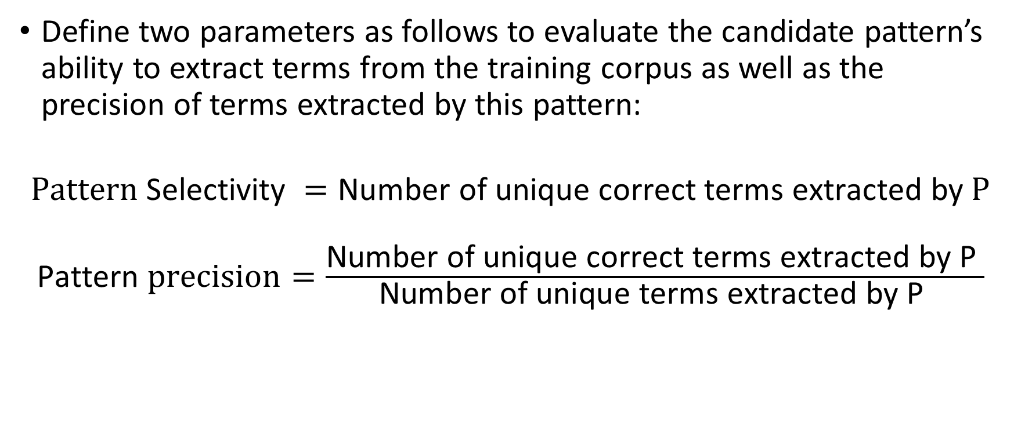
Lexicon Enrichment
Define two parameters as follows to evaluate the candidate pattern’s ability to extract terms from the training corpus as well as the precision of terms extracted by this pattern:
$$Pattern \text{Selectivity} =\text{Number} \text{of} \text{unique} \text{correct} \text{terms} \text{extracted} \text{by} P$$
$\text{Pattern} precision=\frac{\text{Number} \text{of} \text{unique} \text{correct} \text{terms} \text{extracted} \text{by} \text{P} }{\text{Number} \text{of} \text{unique} \text{terms} \text{extracted} \text{by} \text{P} }$

Slide 9
Description Matching
Consider two kinds of features
1. Local context features:
Three words before and after recognized term;
Three words before and after candidate description.
Whether candidate description contains digits;
2. Semantic features:
Number of recognized terms between two terms.
Number of candidate descriptions between two terms;
Number of commas between two terms;
The type of recognized term;

Slide 10
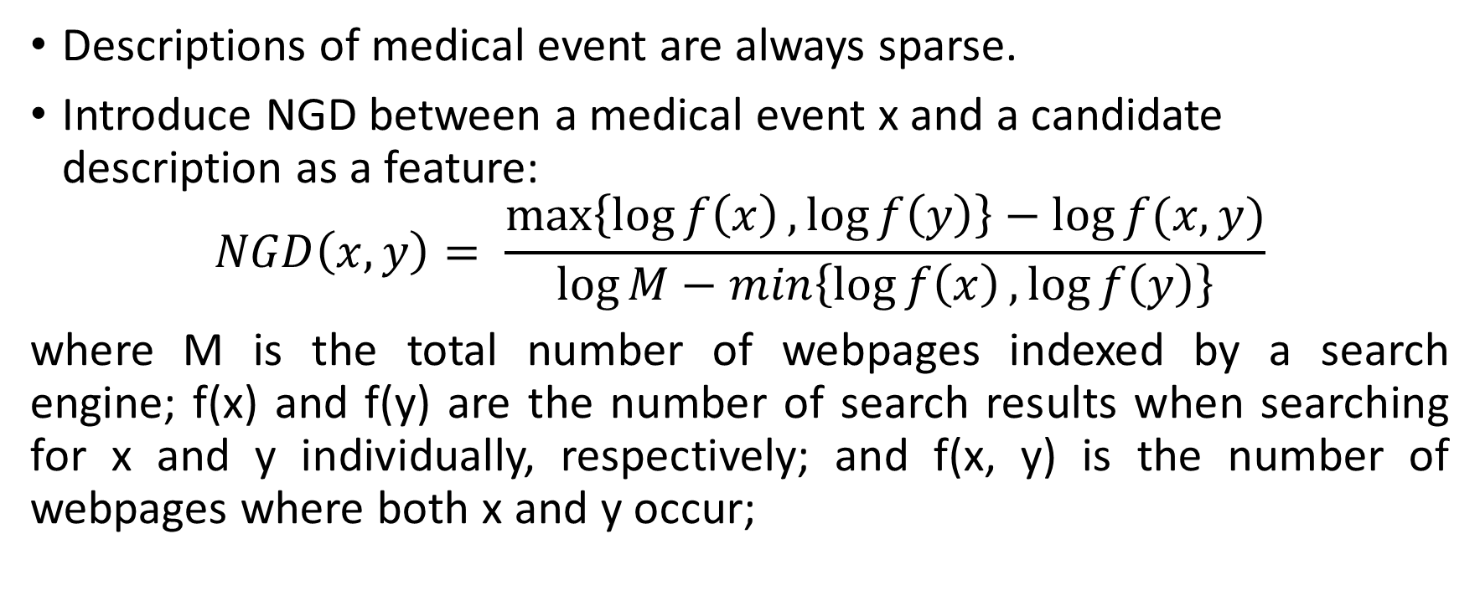
Normalized Google Distance
Descriptions of medical event are always sparse.
Introduce NGD between a medical event x and a candidate description as a feature:
$$NGD\left(x, y\right)= \frac{\max\left\{\log{f\left(x\right)},\log{f\left(y\right)}\right\}−\log{f(x,y)}}{\log{M}−min\left\{\log{f\left(x\right)},\log{f\left(y\right)}\right\}}$$
where M is the total number of webpages indexed by a search engine; f(x) and f(y) are the number of search results when searching for x and y individually, respectively; and f(x, y) is the number of webpages where both x and y occur;

Slide 11
Evaluation
Evaluation on the History of Present Illness, containing 24,817 records
Labeled 400 records (GD-400) for testing and 100 records (GD-100) for parameter tuning
GD-400 contains 9019 medical terms, 1384 temporal terms and 6600 (time-event) tuples. 2262 of the 6600 tuples have descriptions.
GD-100 contains 331 disease terms and 166 drug terms.

Slide 12
Pattern Iteration

Slide 13
Term Recognition Result
 | Our method (enriched lexica) | Lei et al (CRF) | Lei et al (CRF)
 |  | Inexact-match | Exact-match
Disease | 83.9 (85.6/82.2) | 83.1 (78.3/88.6) | 77.4 (72.9/82.5)
Drug | 89.8 (87.5/91.9) | 88.8 (82.2/96.5) | 86.4 (80.0/93.9)
Body Part | 66.3 (79.0/57.1) | 68.6 (58.3/83.4) | 67.4 (57.3/82.0)
Procedure | 59.5 (54.7/65.3) | 60.0 (44.1/93.8) | 56.0 (41.2/87.5)
Symptom | 94.4 (93.3/95.5) | 94.6 (93.5/95.6) | 94.1 (93.1/95.1)
Clinical Test | 95.5 (96.7/94.3) | 96.5 (97.0/96.1) | 96.0 (96.5/95.6)
Total | 89.6 (90.5/88.6) | 89.8 (86.1/93.7) | 88.3 (84.7/92.2)
Values are F1-score (recall/precision) (%)

Slide 14
Description Matching
 | Recall (%) | Precision (%) | F1-score (%)
NGD SVM | 89.2 | 85.6 | 87.4
SVM without NGD feature | 86.8 | 80.9 | 83.8
Patrick et al | 89.5 | 78.8 | 83.8

Slide 15
Conclusion
Introduce a framework for extracting structured records from Chinese EMRs and obtain an accuracy of 0.846 on end-to-end result.
Propose an iterative bootstrapping algorithm to enrich lexica.
Use NGD as a feature to compute correlation between events and descriptions.

Slide 16
Thank You

